Slide 1
FLAMES
Spatial Analysis course
Day 3

Slide 2
7
Coordinate Systems/Spatial Projections

Slide 3
7
Projection | WKID | Authority | Syntax
UTM NAD 83 Zone 19N | 26919 | EPSG | +proj=utm +zone=19 +ellps=GRS80 +datum=NAD83 +units=m +no_defs
USA Contiguous albers equal area | 102003 | ESRI | +proj=aea +lat_1=29.5 +lat_2=45.5 +lat_0=37.5 +lon_0=-96 +x_0=0 +y_0=0 +ellps=GRS80 +datum=NAD83 +units=m +no_defs
Alaska albers equal area | 3338 | EPSG | +proj=aea +lat_1=55 +lat_2=65 +lat_0=50 +lon_0=-154 +x_0=0 +y_0=0 +ellps=GRS80 +datum=NAD83 +units=m +no_defs
World Robinson | 54030 | ESRI | +proj=robin +lon_0=0 +x_0=0 +y_0=0 +ellps=WGS84 +datum=WGS84 +units=m +no_defs

Slide 4
9.a
Spatial Statistics – part I

Slide 5
9.a
i- Proximity interpolation

Slide 6
9.a.i
Given a distribution of point meteorological stations showing precipitation values, how I can I estimate the precipitation values where data were not observed?

Slide 7
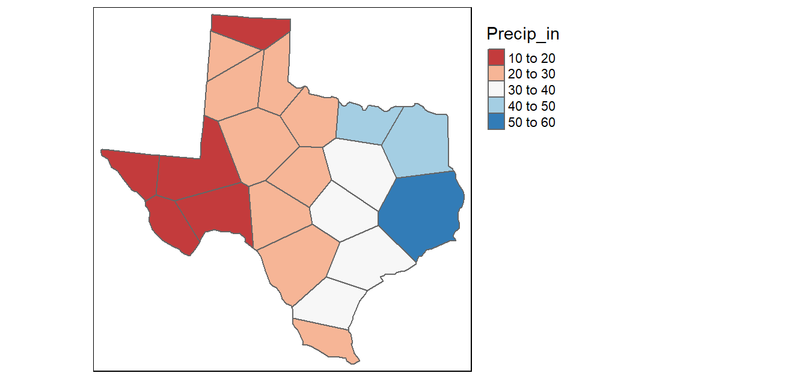
9.a.i
Thiessen Polygons

Slide 8
9.a
ii- Inverse Distance Weighted (IDW)

Slide 9
9.a.ii
Average value for unsampled locations using values from nearby weighted locations.

Slide 10
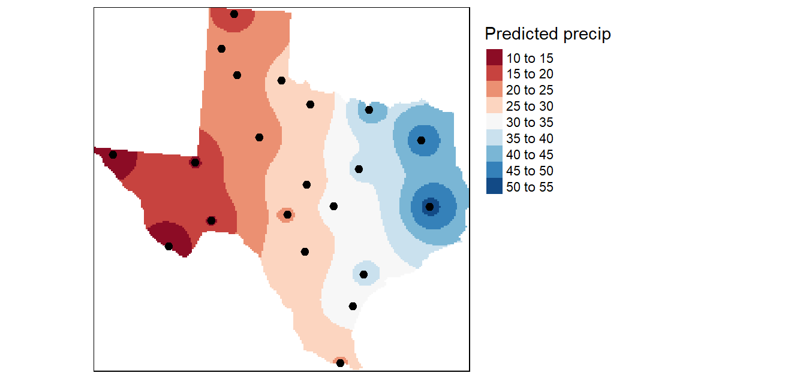
9.a.ii

Slide 11
9.a.ii
The larger the power coefficient, the stronger the weight of nearby points.
A higher power coefficient results in nearby points having greater influence on the unsampled locations.

Slide 12
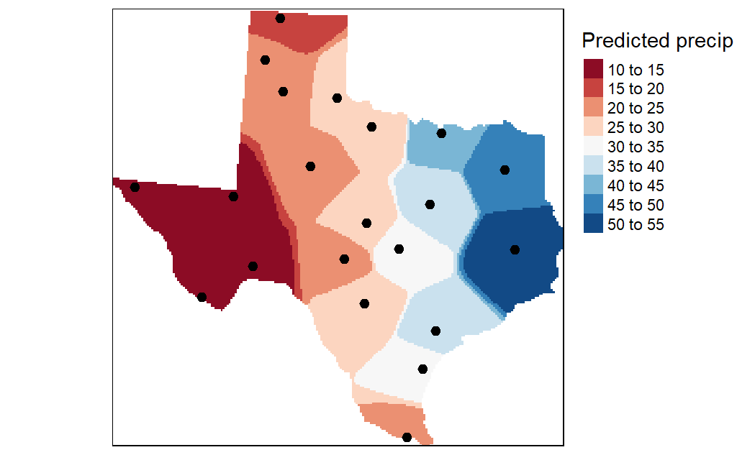
9.a.ii
coef = 2
coef = 15

Slide 13
9.a.ii
Thiessen Polygons
IDW

Slide 14
9.a
iii- Ordinary Kriging

Slide 15
i- Ordinary Kriging
1- Removing any spatial trends if present.
2- Computing the experimental variogram (spatial autocorrelation)
3- Defining an experimental variogram model.
4- Interpolating the surface using the experimental variogram.
5- Adding the kriged interpolated surface to the trend interpolated surface to produce the final output.

Slide 16
i- Ordinary Kriging
To perform kriging, you must first have a variogram model, from which the data can be interpolated. There are a couple steps involved:
Calculate the sample variogram. This is done with the variogram function.
Fit a model to the sample variogram.

Slide 17
i- Kriging
Variogram (https://vsp.pnnl.gov/help/Vsample/Kriging_Variogram.htm)
A variogram is a description of the spatial continuity of the data or spatial autocorrelation.
The experimental variogram is a discrete function calculated using a measure of variability between pairs of points at various distances. The exact measure used depends on the variogram type selected

Slide 18
i- Kriging
The cutoff represents the maximal spatial distance considered between two observations.
The width is the distance interval over which the semi-variance is calculated.

Slide 19
9.a
Spatial Statistics – part I
(r script)

Slide 20
Thank you

